Slide 1
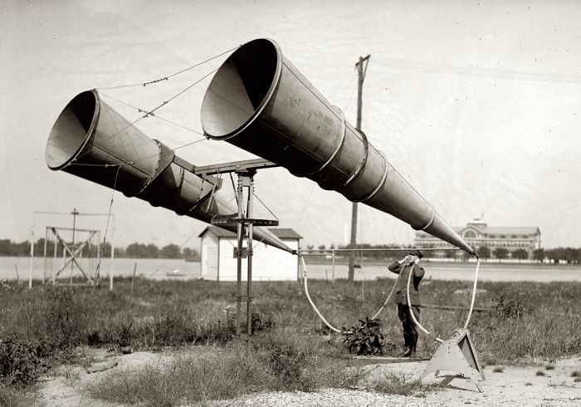
Sonic
Interaction
Design
Exploring Sound

Slide 2
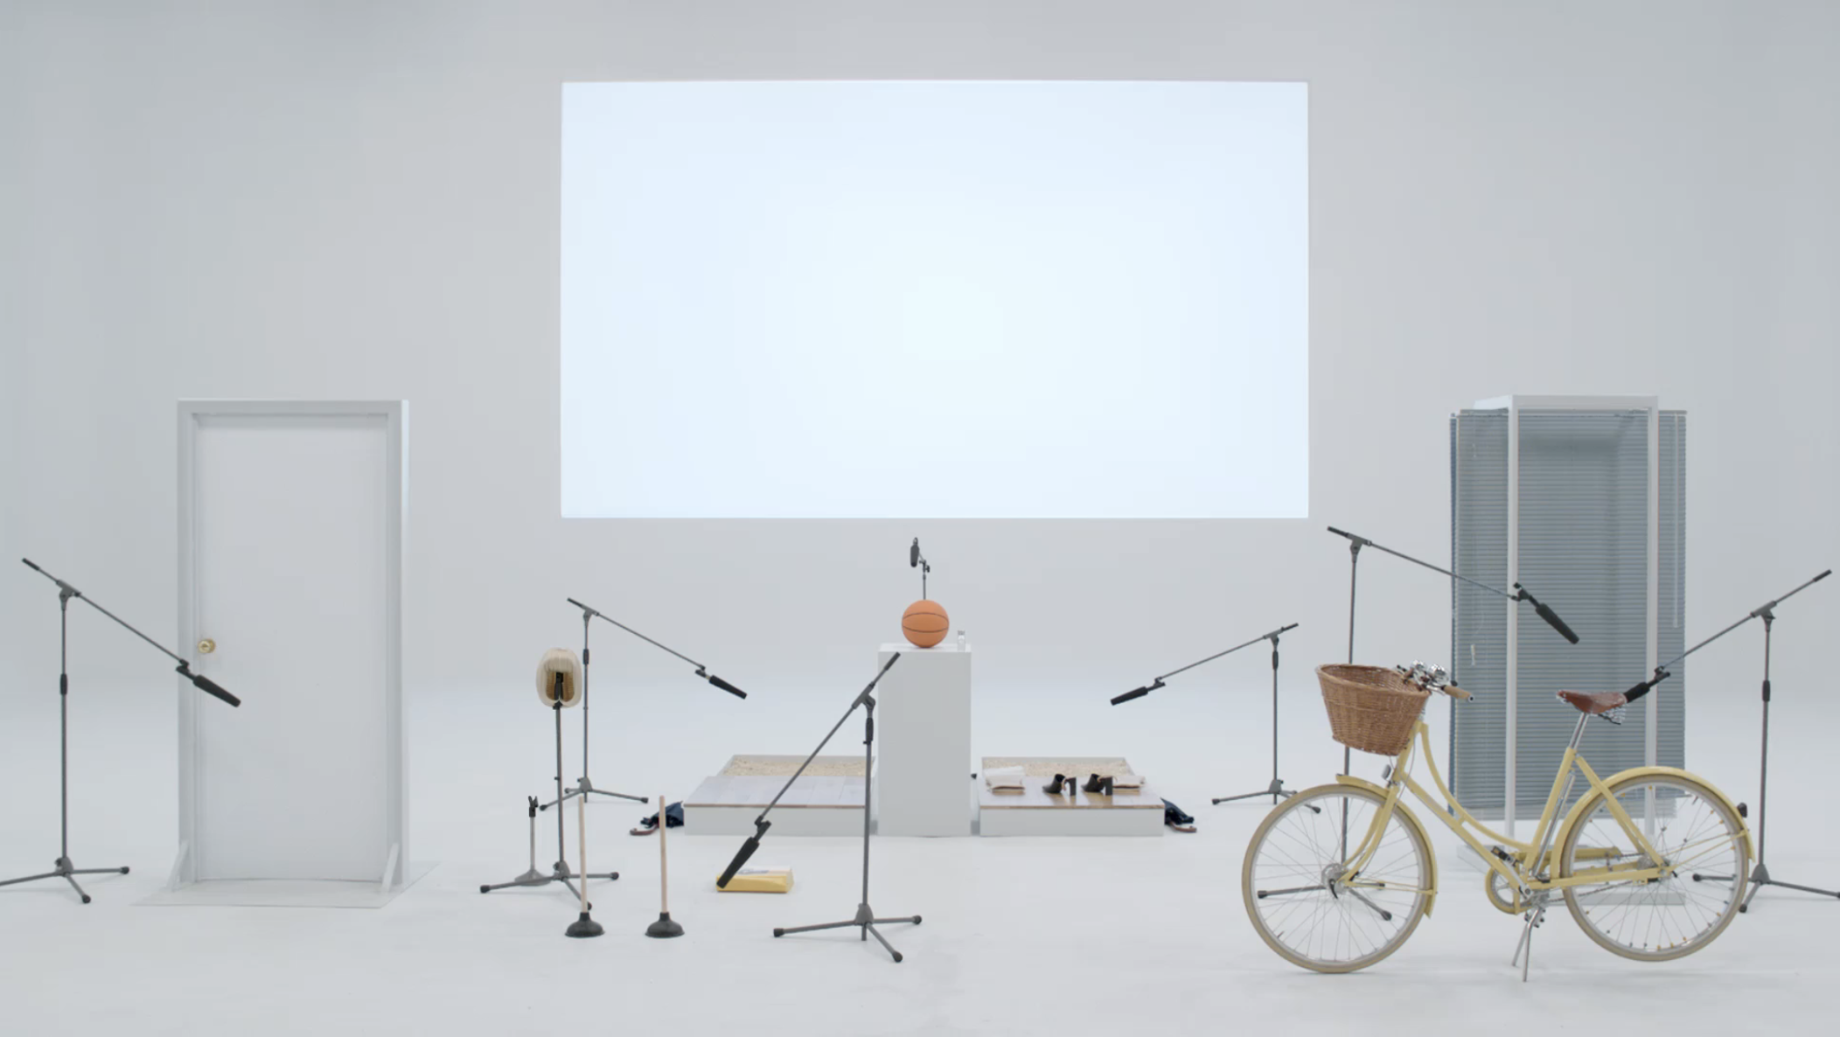
The Sound of COS
https://www.youtube.com/watch?v=HZYUqZ6kjZE

Slide 3
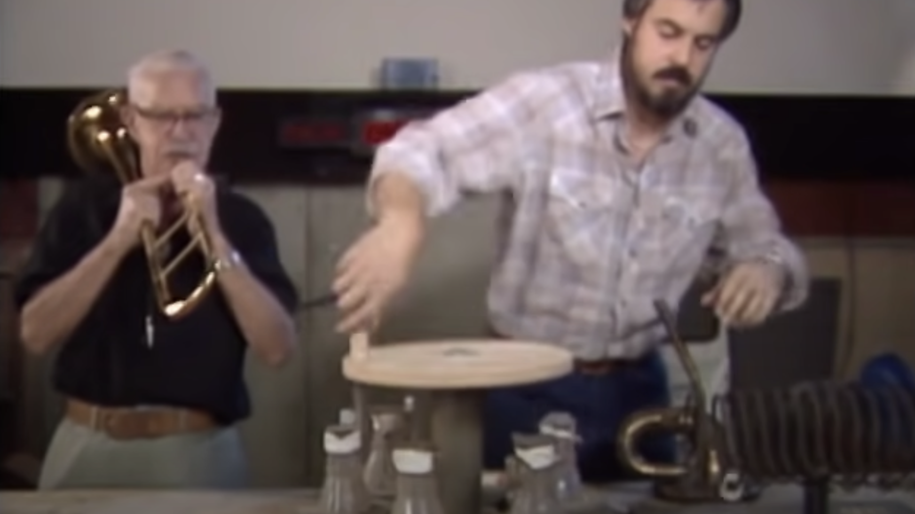
Wall-E Animation Foley and Sound Design
https://www.youtube.com/watch?v=0IPxIvbc_cs&t=579s

Slide 4
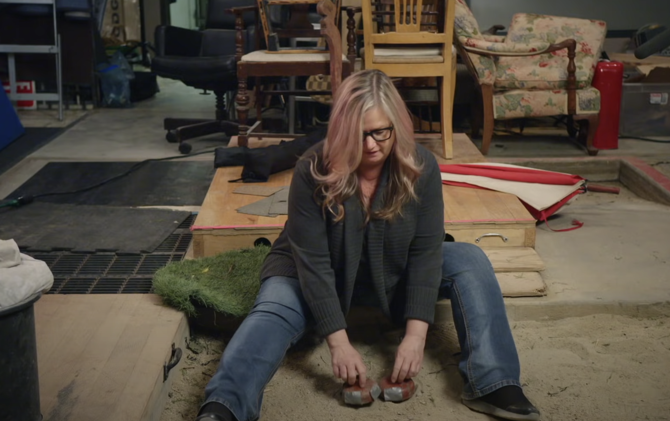
The Magic of Making Sound
https://www.youtube.com/watch?v=UO3N_PRIgX0

Slide 5
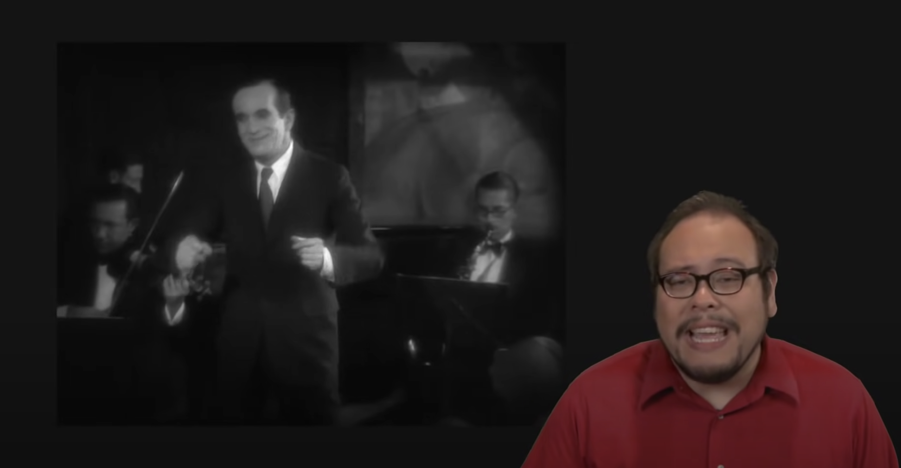
The History of Sound at the Movies
https://www.youtube.com/watch?v=Ot5IryUt9SM

Slide 6
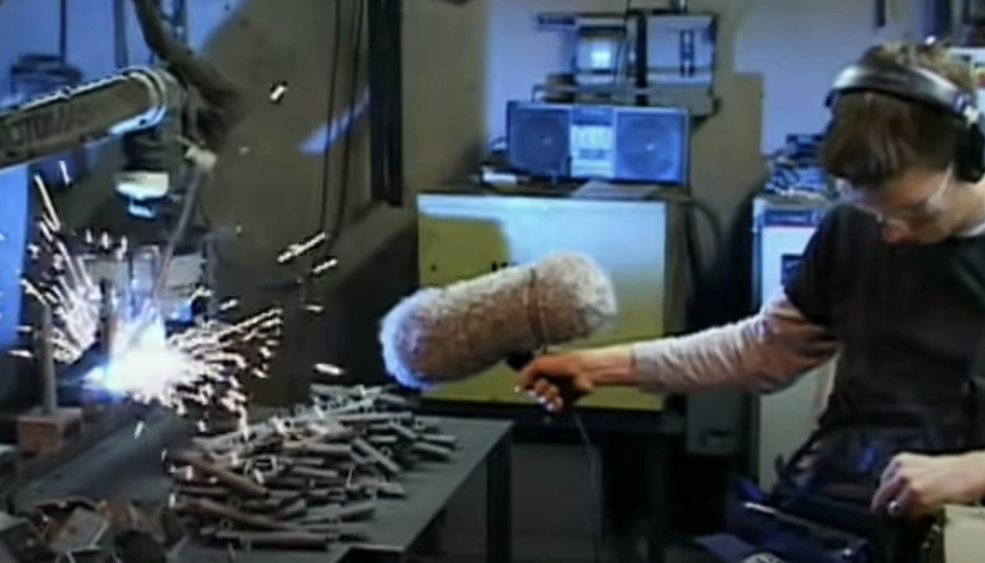
Sound Design - Star Wars Episode II
https://www.youtube.com/watch?v=5ogCVi0WqrQ

Slide 7
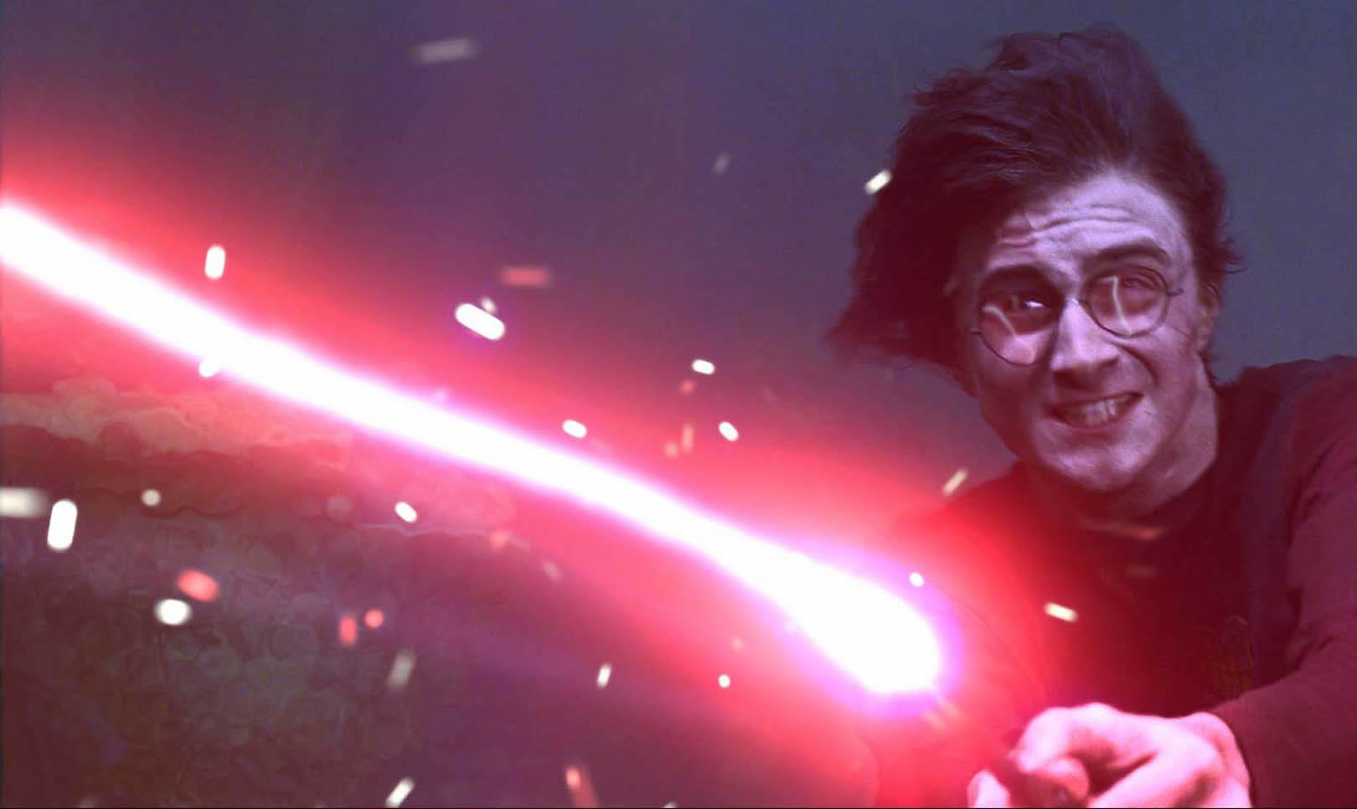
Sound and Action: Who‘s in Charge Here?
„Every sufficiently advanced technology
is indistinguishable from Magic.“
Arthur C. Clarke
Notes:
We can ask ourselves:
Do we control the technology?
Is technology magic?

Slide 8
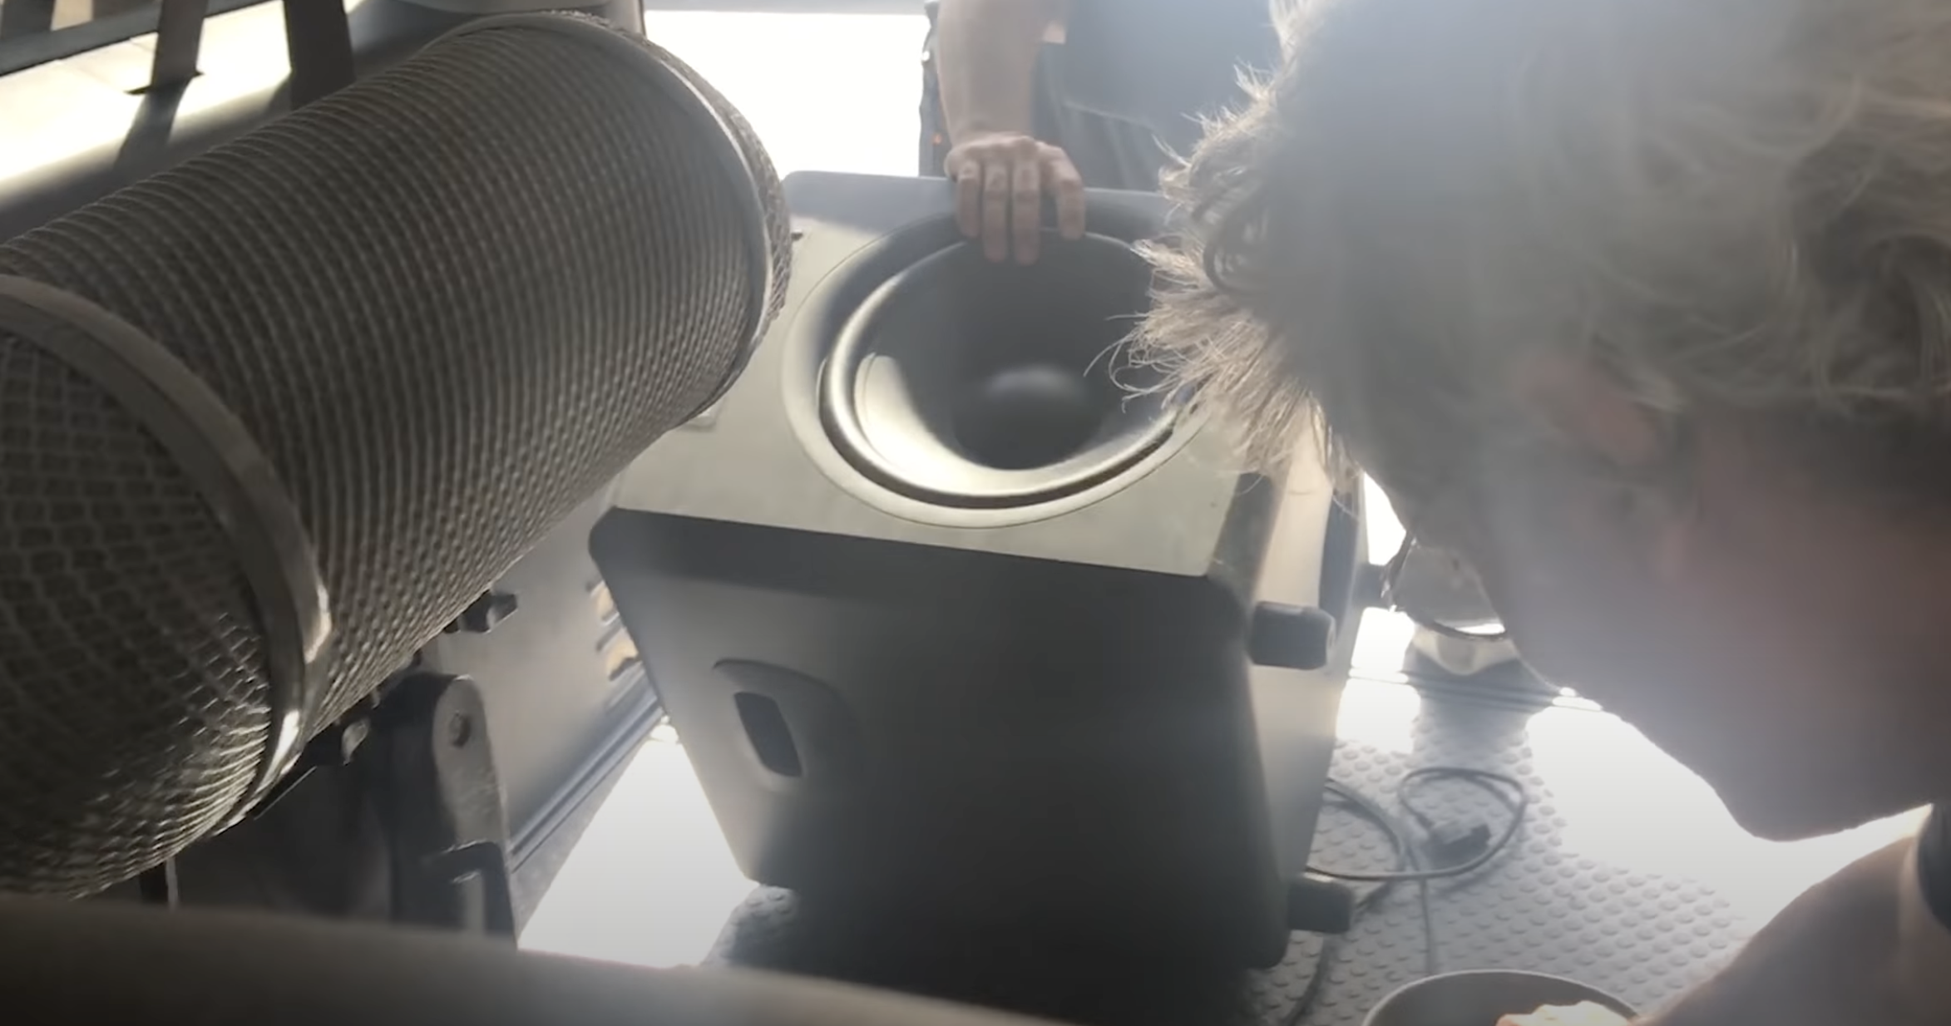
The Sound of Blade Runner 2049
https://www.youtube.com/watch?v=bJvOqXdsEp8

Slide 9
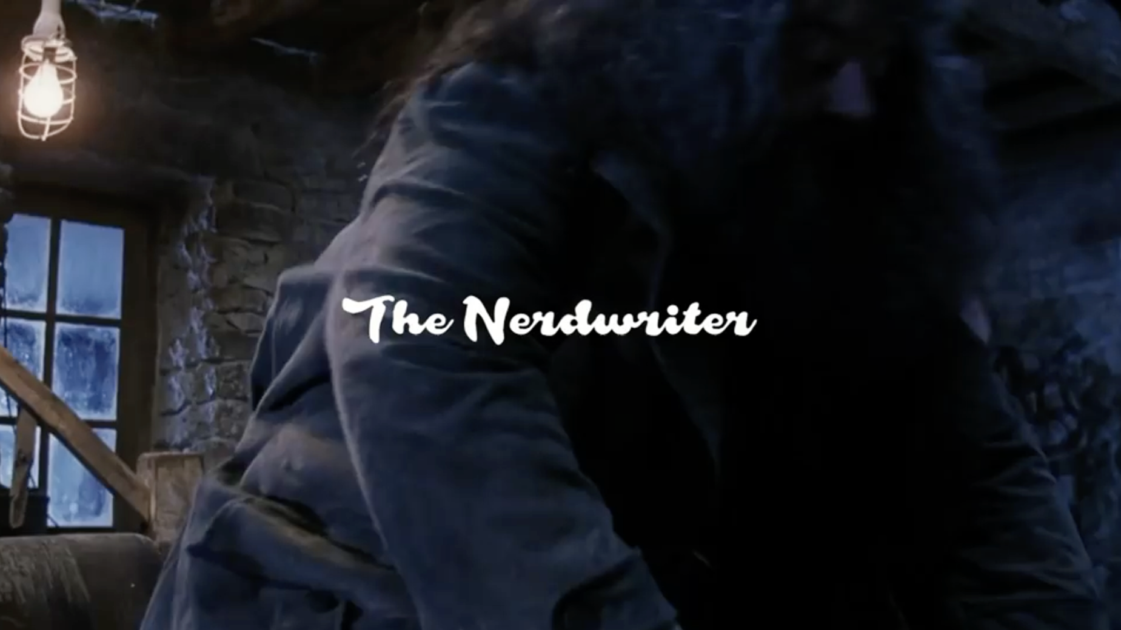
Harry Potter: What Magic Sounds Like
https://www.youtube.com/watch?v=bJvOqXdsEp8

Slide 10
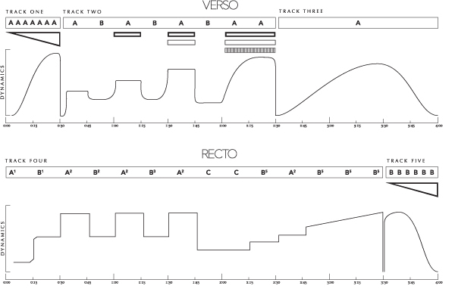
Planning and “previs”

Slide 11
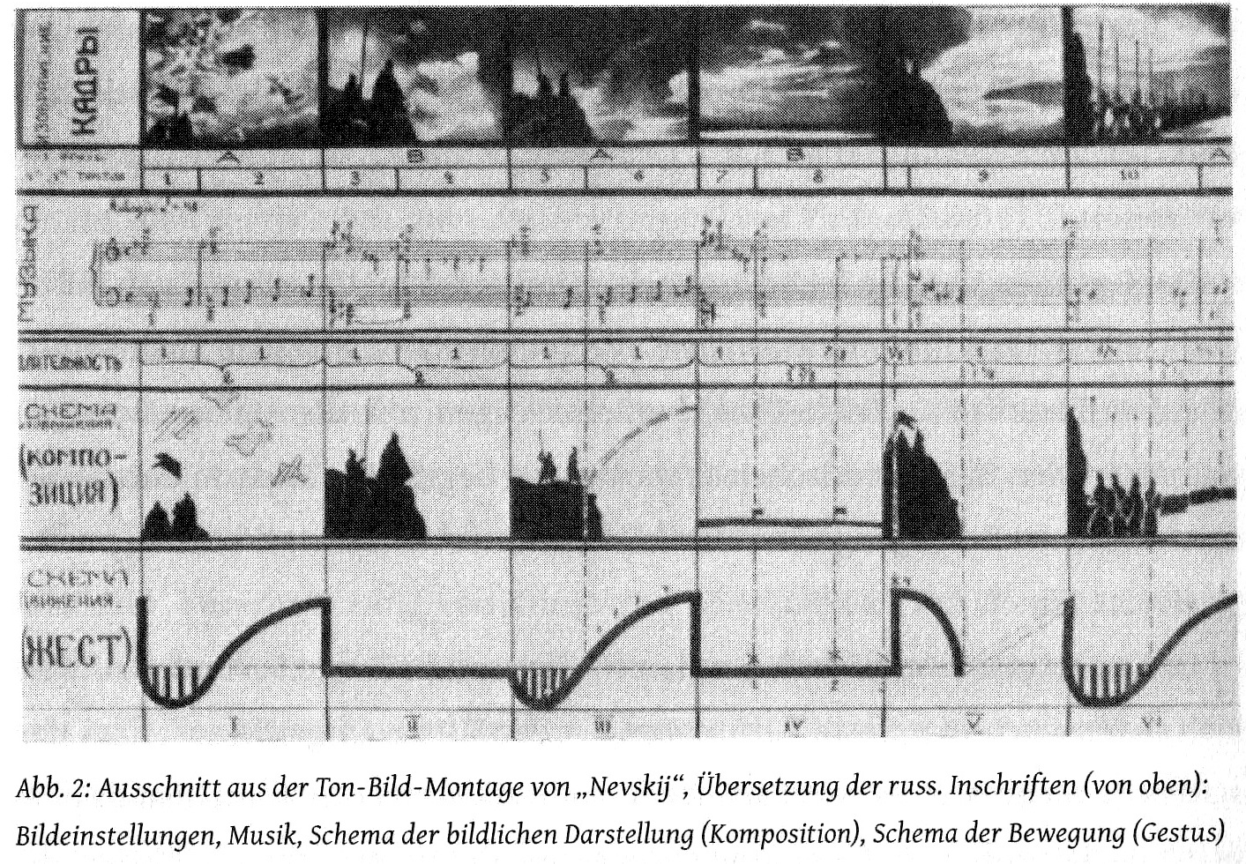
Planning and “previs”

Slide 12
Planning and “previs”
Middleton’s gesture-analysis diagram of Madonna: Where’s the Party (from: Zeiner-Henriksen, 2010)

Slide 13
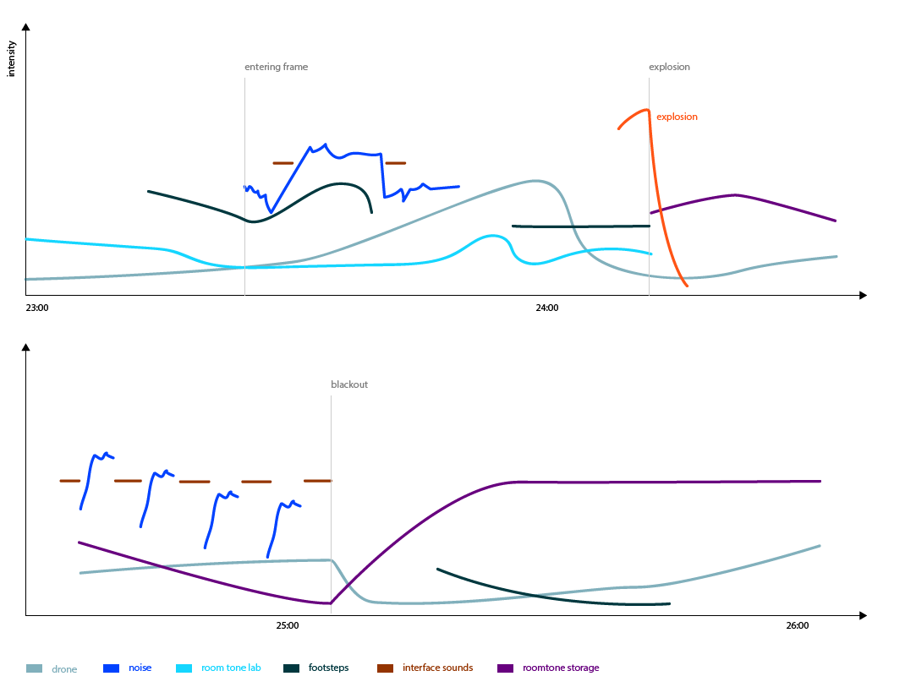
Planning and “previs”

Slide 14
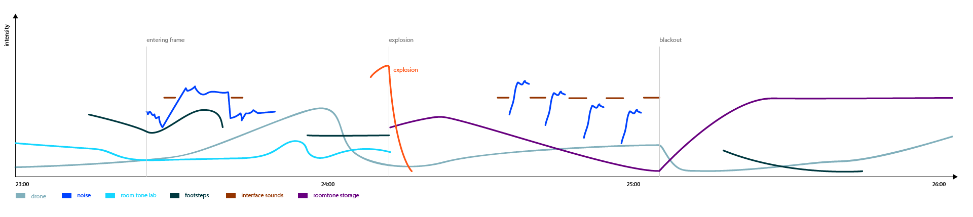
Planning and “previs”

Slide 15
Planning and “previs”

Slide 16
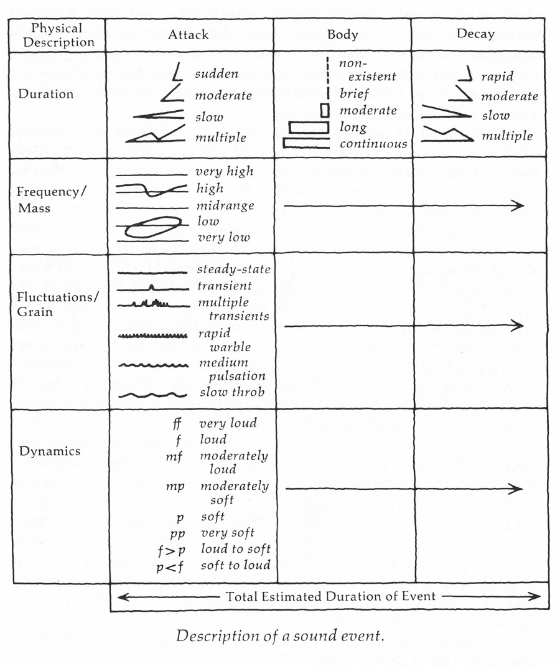
Planning and “previs”

